Slide 1
3. Record a 5-10 minute presentation with the following requirements
a) You should be visible in the video, at a minimum at the introduction and at the end
b) The presentations from step 1 and 2 should be visible
c) Your solution to the use case should be demonstrated and recorded during the video
d) Put this video to your Youtube channel and name it as follows
IBM Coursera Advanced Data Science Capstone – YOUR NAME

Slide 2
2022 Case Study
Location identification by using RSSI from beacons

Slide 3
About the presentation
Information for stakeholders:
About the data set
The use case
The solution to the use case (e.g. your report/notebook, deployed model or data product)
Information for data scientists:
Architectural choices
Data quality assessment, data pre-processing and feature engineering
Model performance indicators
Model algorithm
Rubrics questions have been answered in the Architectural Decisions Document (ADD).

Slide 4
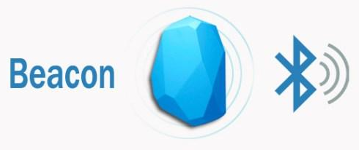
The use-case
Objective: Location identification on indoors
Locating a person indoors based on the received signal strength indicator (RSSI) readings from multiple BLE beacons.
But, what is RSSI?
Notes:
is a measurement of the power present in a received radio signal

Slide 5
Challenges
Challenge 1
Challenge 2
Challenge 3
Beacons deployment
We need to place the minimum number of beacons required to track the activities indoors in order to minimize costs of deployment.
RSSI signals
Once we read the signals we need to clean them in order to use that information for the model or algorithms.
Modeling
Once the information is prepared, we need to create a model to predict an end-user's location indoors.

Slide 6
Data set
The RSSI was collected from multiple BLE beacons deployed at home (real data).
The beacons were configured to broadcast signals each 100ms.
12 experiments were conducted in different places at home in order to read the signals from all the beacons and thus had a grand truth for the final model. Each experiment last more than 40 seconds.
70% of the experiments where assigned for training and the remaining for testing datasets.

Slide 7
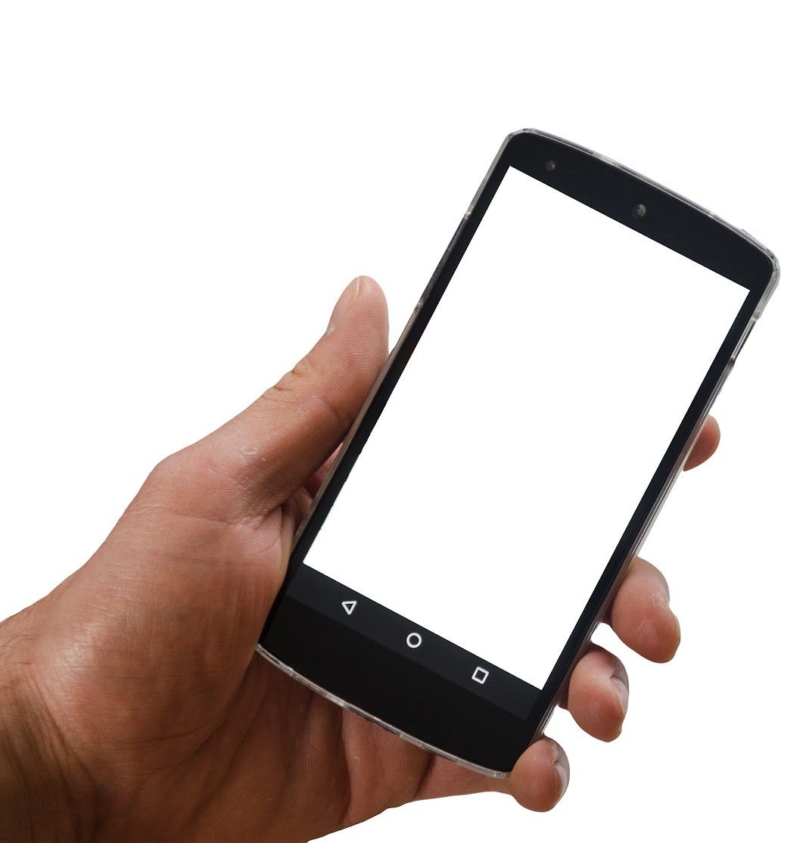
Solution
Our solution is to create a machine learning algorithm able to predict the location of a end-user who is holding a smartphone indoors.

Slide 8
Implementation

Slide 9
Explore the data collected from the beacons.
Creating new features based on the training dataset.
Calculate metrics of the trained model
Data exploration
ETL
Feature creation
Model training
Model evaluation
Model deployment
Checking variables and start extraction, transformation and Loading process
Start the training process.
Deploy model with new data.

Slide 10
Process

Slide 11
BLE Beacons deployment
1
2 Bath
11
10 Study
3
12
4 Living room
5 Kitchen
8 Main
9 Room2
6
7

Slide 12
Architectural choice
Android app to record RSSI signals.
Google drive to store experiments (CSV files).
Jupyter notebooks to check on data,create model and deployment.
Visualizations
Future
PostgreSQL, dashboards

Slide 13
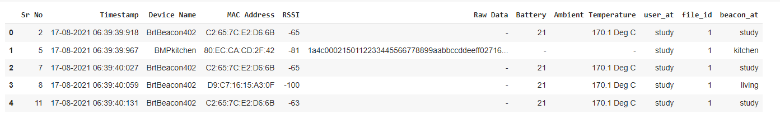
Data exploration (1)
The results from data exploration are located in its own Jupyter notebook.

Slide 14
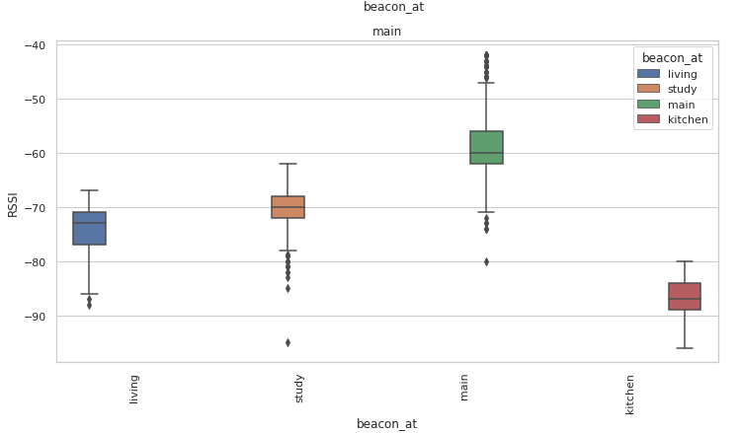
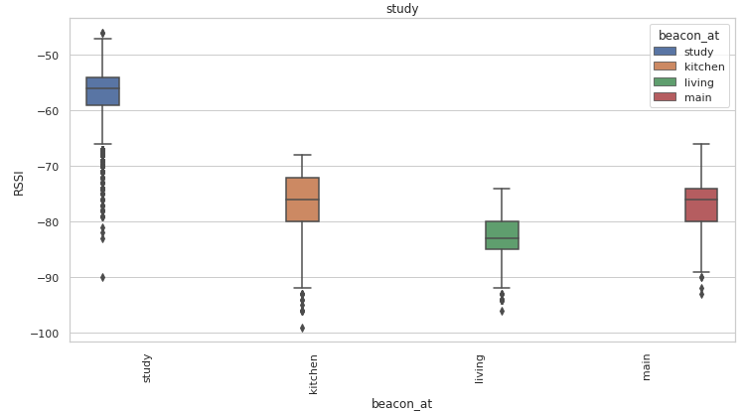
Data exploration (2)
Examples

Slide 15
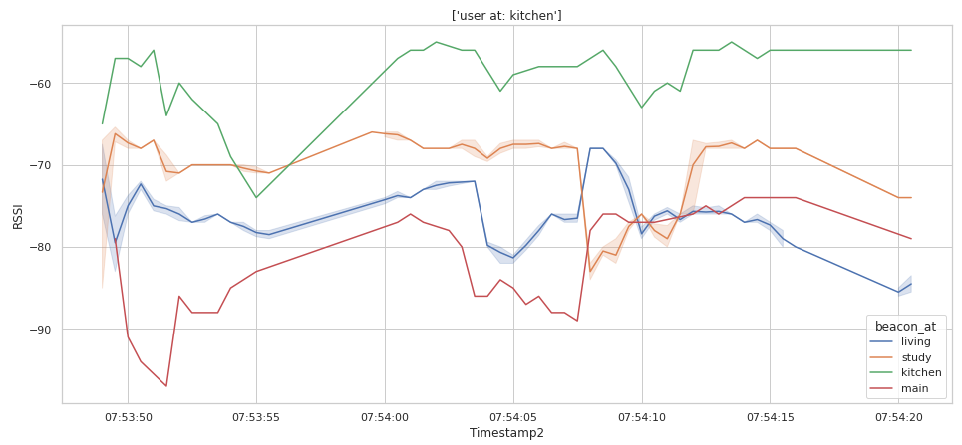
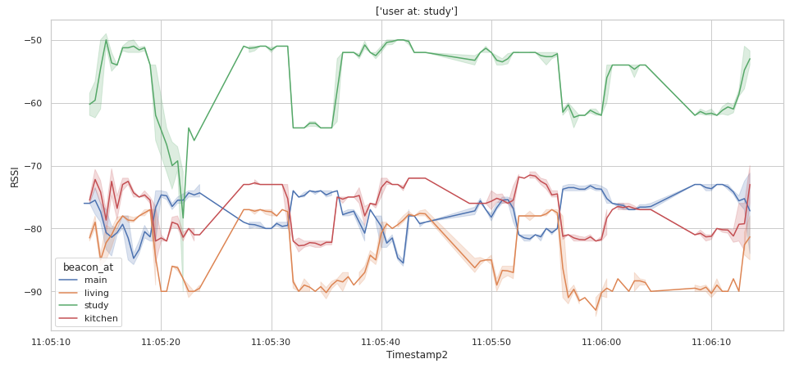
Data exploration (3)

Slide 16
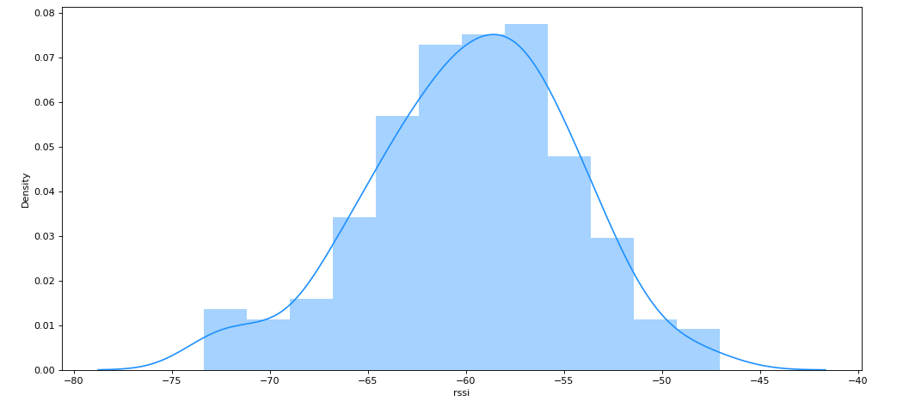
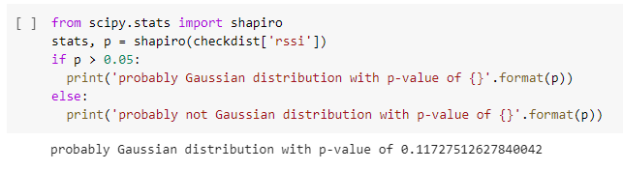
2. ETL process
Checking RSSI distributions

Slide 17
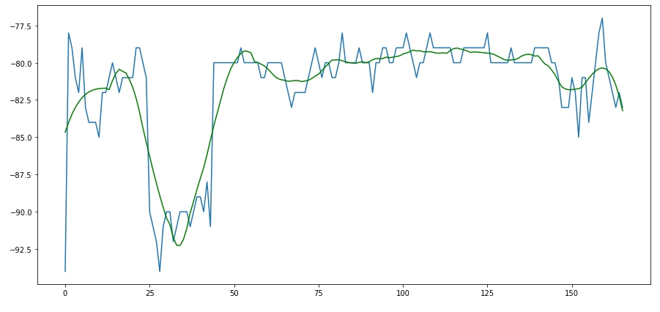
ETL and Feature engineering
Data quality assessment
Savitzky-Golay filter for noise removal
RSSI
timestamp

Slide 18
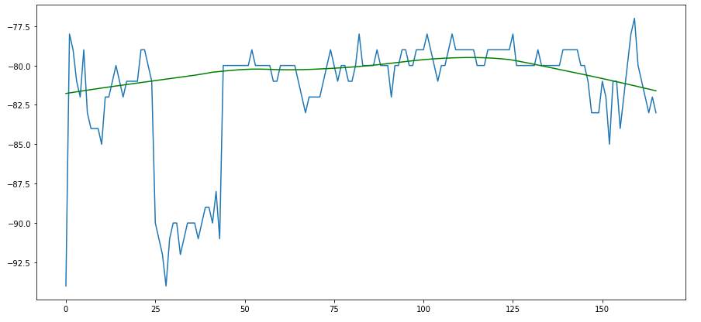
ETL and Data pre-processing
Loess smoothing method
RSSI
timestamp

Slide 19
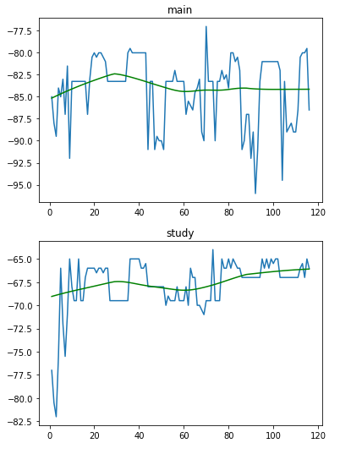
Feature engineering
Imputing missing data with median for all the beacons depending on experiments and their placement. The median was chosen since it is not as affected as the mean in the presence of outliers.
timestamp

Slide 20
Model
Scaling data
Using label encoder for our target.
Conducting 2 experiments:
Baseline (decision tree algorithm)
Deep learning model

Slide 21
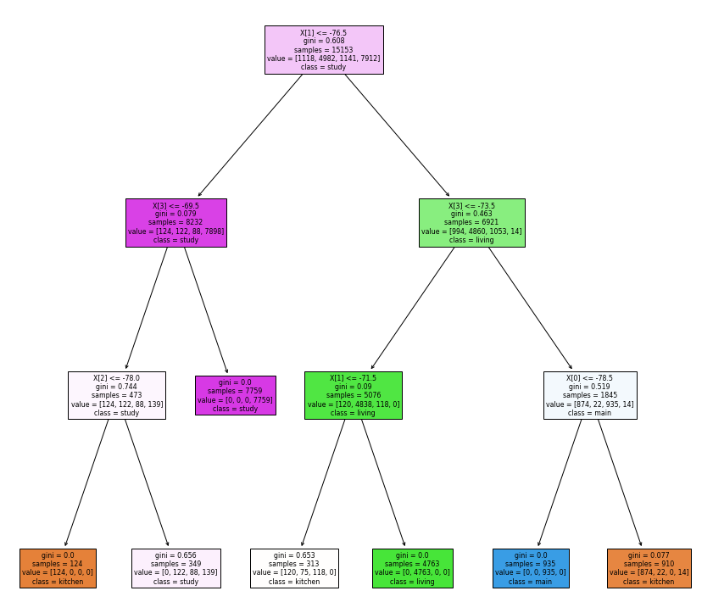
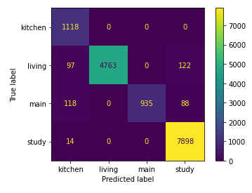
Decision tree
It worked well with training data but had some issues with some features for the testing dataset.
The model reached a macro avg F1-score of 0.94 with testing dataset, a precision of 0.95 and recall of 0.93.

Slide 22
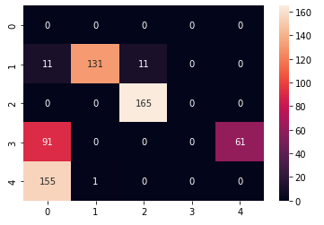
Issues related to beacons deployment
Deep learning algorithm
Metrics
Balanced accuracy score (The balanced accuracy in binary and multiclass classification problems to deal with imbalanced datasets. It is defined as the average of recall obtained on each class.)
0.46
Hamming loss (Hamming distance between two sets of samples)
0.53
Recommendation: Try at least with 1 more beacon per area.

Slide 23
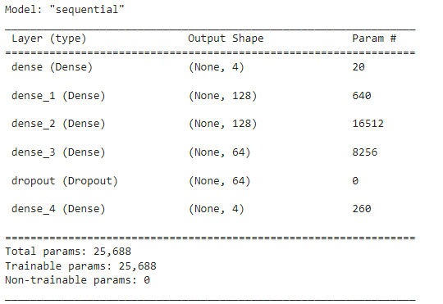
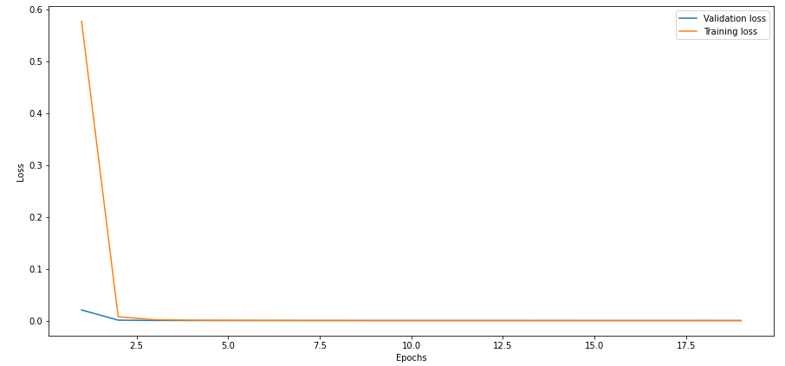
Deep learning model (final model)
Validation and training losses
EarlyStopping function

Slide 24
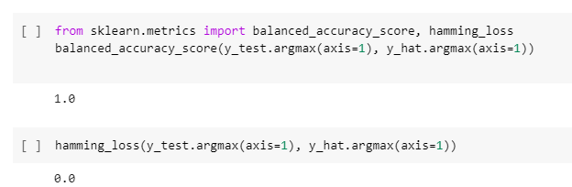
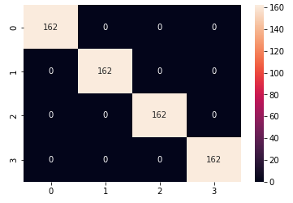
Deep learning model (final model - metrics)
Confusion matrix with testing dataset

Slide 25
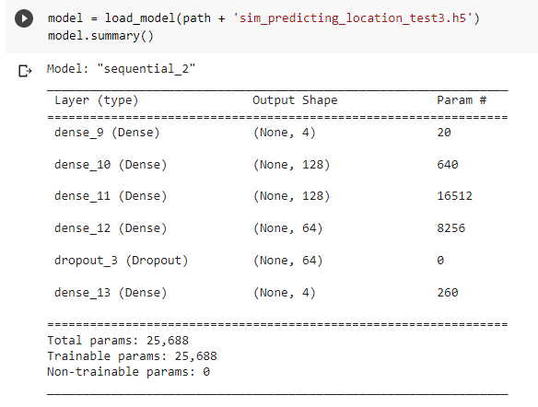
Deployment (1)
Deployment on a Github’s notebook

Slide 26
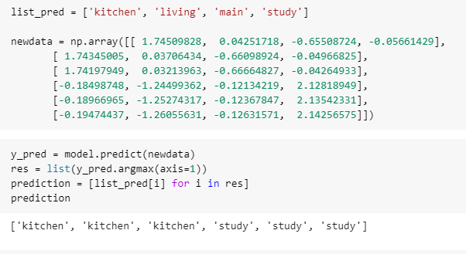
Deployment (2)

